Slide 1
From €300k to €3 million in 3 years Online
Is it rocket science?

Slide 2
Yes, it’s Rocket Science…
… for kids!

Slide 4
1. More Geographies & Sales Channels
2020 Online Store in Portugal & Spain Amazon Spain (1P)
2021 Amazon France, Italy, Germany, Netherlands (1P, 3P FBA FBM)
B2C Marketplaces in Portugal (Worten, FNAC, WOOK)
2022 Amazon United Kingdom (1P, 3P FBA)
International B2B Marketplaces (Faire, Ankorstore, Orderchamp)
2023 Amazon USA (3P FBA)

Slide 5
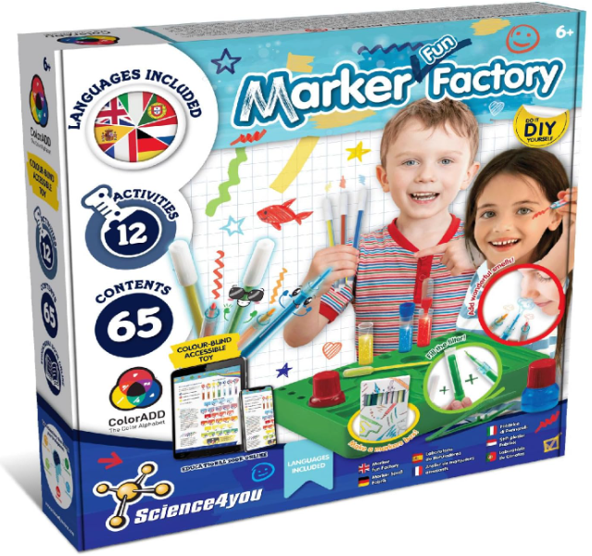
2. Online-Only Product
NEW Multilanguage SKUs
Online instructions & educational book
Smaller box size

Slide 6
3. New Logistics model
From B2B to B2C

Slide 7
4. New Product Innovation Algorithm
Online data
New categories

Slide 8
linkedin.com/in/filipevalmeida
Filipe Almeida

